Slide 1


NEXT GEN EMPLOYABILITY PROGRAM
CREATING A FUTURE-READY WORKFORCE
Student Name :
Soham M. Kulkarni
Student ID :
College Name :
STU67853cd8c8fb71736785112
Sinhgad Institute Of Management, Pune

Slide 2
CAPSTONE PROJECT SHOWCASE
Project Title
Bid On An Online Auction Platform
Abstract | Problem Statement | Project Overview | Proposed Solution | Technology Used | Modelling & Results | Conclusion | Q&A

Slide 3
Abstract
Bid On is a cutting-edge online auction platform designed to modernize the traditional auction process by introducing an accessible, user-friendly, and secure online environment. This platform enables users to engage in real-time competitive bidding for a wide variety of products.
Developed using the MERN Stack (Node and Express for the backend and React for the frontend), Bid On promises a responsive and visually appealing interface. The MongoDB is employed for data management, supporting essential features such as user authentication, product listing, product management, real-time bidding, and user feedback.
In contrast to existing auction platforms, Bid On addresses common challenges such as user engagement, security vulnerabilities, and real-time responsiveness, offering a streamlined user experience with enhanced functionality. It fosters a transparent and dynamic bidding environment that not only encourages more frequent participation but also boosts the integrity and trustworthiness of online auctions. The platform is specifically designed to cater to the needs of both casual and serious auction participants, from individual buyers and sellers to commercial entities looking to liquidate assets or procure goods in a competitive, auction-based marketplace.

Slide 4


Problem Statement
Existing online auction platforms often struggle with poor user engagement, slow adaptability to new technologies, inadequate customer support, and a lack of specialized services for niche collectors.
These limitations result in a suboptimal user experience and leave collectors of rare and high-value items underserved. There is a need for a dedicated platform that caters specifically to collectors of niche items such as collectibles, coins, currencies, figurines, and trading cards, providing an enhanced user experience with improved engagement, adaptability, and tailored auction services.

Slide 5

Project Overview
The primary goal of Bid On is to create an engaging and efficient auction environment where buyers and sellers can seamlessly interact.
Target Audience:
Collectors of Various Niches:
Individuals passionate about rare and valuable collectibles.
Casual and Serious Collectors:
Users ranging from hobbyists to professional collectors.
Dealers and Private Sellers:
Small-to-medium-sized businesses and individuals looking for auctioning their
collections.
Key Features:
User Authentication:
Secure registration and login processes.
2.Product Listing & Management:
Simple and intuitive listing tools for sellers.
High-quality image and description support.
Dashboard for sellers to track bids and manage sales.
3.Real-Time Bidding System:
Instant bid updates and notifications.

Slide 6
Proposed Solution
Bid On is a specialized online auction platform designed to cater to collectors of niche items such as collectibles, coins, figurines, trading cards, and comic books. The platform aims to address the shortcomings of existing auction systems by offering a seamless, user-friendly, and transparent marketplace.
To achieve this, Bid On will feature an intuitive user interface that ensures easy navigation and accessibility to core functionalities, including product listing, bidding, and feedback mechanisms.
A real-time bidding system will be implemented, providing instant updates and notifications to enhance user engagement and create a dynamic auction experience.
To foster trust and credibility, a transparent user feedback system will allow buyers and sellers to rate and review transactions, ensuring accountability within the marketplace.
Additionally, the platform will include comprehensive documentation covering system architecture, design decisions, and implementation guidelines, facilitating future improvements and maintenance.
As a solo project, Bid On will be developed with a structured approach, ensuring scalability and efficiency.
By addressing the key pain points of existing systems, Bid On will create a specialized, engaging, and reliable auction platform for collectors.

Slide 7
Technology used
The Bid On platform is built using the MERN stack (MongoDB, Express.js, React, and Node.js) along with additional modern tools to enhance functionality, security, and user experience. Below is a detailed breakdown of the technologies used:
Backend - Node.js with Express.js
Node.js: A powerful JavaScript runtime used for building scalable and high-performance server-side applications, crucial for handling real-time auctions. Express.js: A minimal and flexible Node.js framework that simplifies backend development with robust routing, middleware integration, and API management.
JWT (JSON Web Token): Used for secure user authentication, ensuring only authorized users can access restricted functionalities.
bcrypt.js: A password hashing library that securely encrypts user passwords before storing them in the database, enhancing security.
Database - MongoDB
MongoDB: A NoSQL database designed for handling large volumes of auction-related data, including user profiles, listings, and bid history. Its flexible schema makes it ideal for dynamic applications.

Slide 8
Frontend - React and Additional Libraries
React.js: A JavaScript library for building fast and interactive UI components, ensuring a seamless user experience with efficient rendering of real-time bid updates.
Inline CSS: Used for styling specific components directly within React, allowing for quick and component-specific design adjustments.
Tailwind CSS: A utility-first CSS framework that provides a responsive and modern design while simplifying layout customization.
react-hot-toast: A notification library used to display real-time success, error, and info messages, improving user feedback and interaction.
lucide-react: A lightweight and customizable icon library used to enhance UI elements with visually appealing icons.
Key Advantages of This Tech Stack
Scalability: The MERN stack enables easy scalability for handling increasing users and auctions.
Security: JWT authentication and bcrypt password encryption ensure a secure platform.
Performance: Real-time updates with React and efficient data handling with MongoDB.
User Experience: React-hot-toast and Lucide icons improve interactivity and visual appeal.

Slide 9
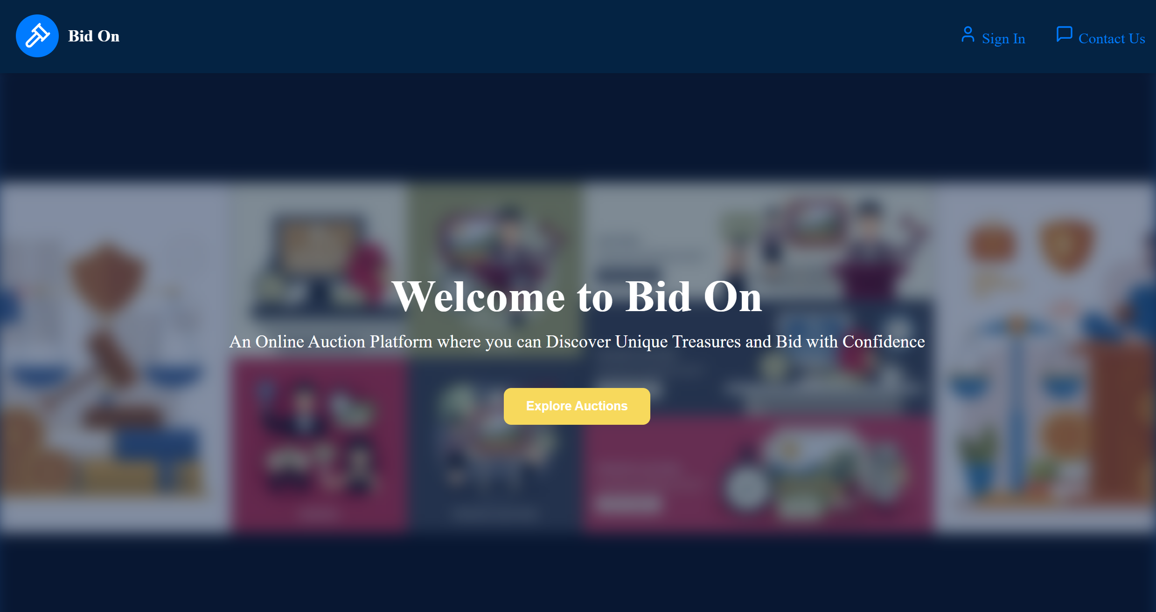
Modelling & Result

Slide 10
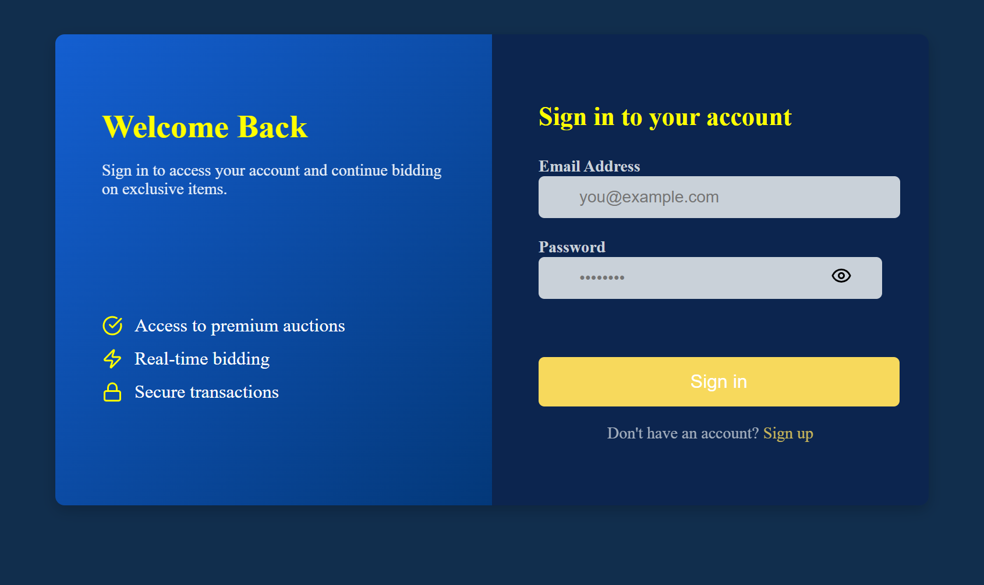

Modelling & Result

Slide 11
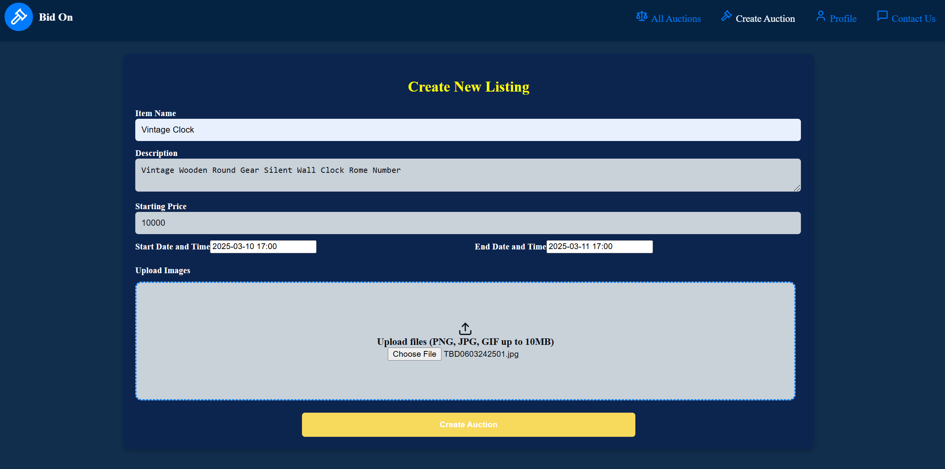
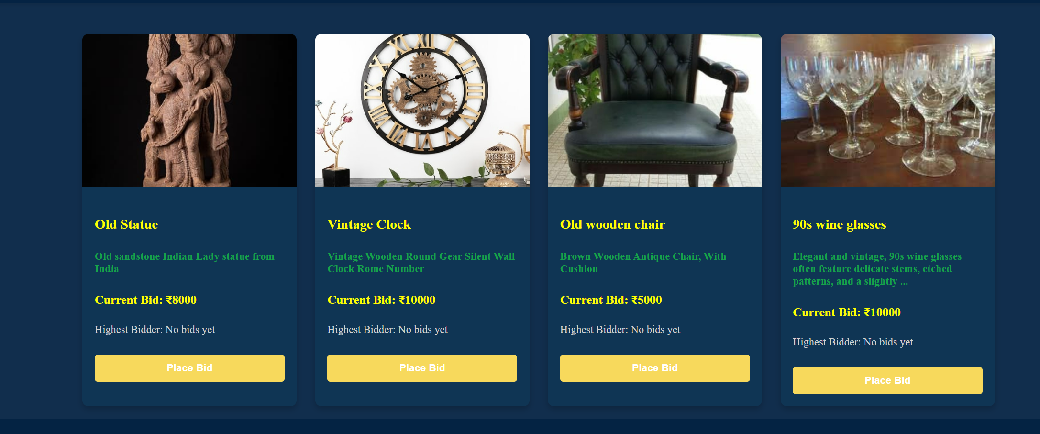
Modelling & Result

Slide 12
Proposed Future Enhancements for Bid On:
Advanced Personalization:
AI-driven recommendations based on user preferences and past bidding activity.
Collaborative Bidding & Group Auctions:
Allows multiple users to bid together or share auction alerts.
Offline Access & Notifications:
Enables offline viewing of auctions and real-time bid notifications.
Expanded Auction Features:
Supports multi-item auctions, direct negotiations, and instant "Buy Now" options.
Real-Time Assistance & Support:
Provides virtual assistants and live chat for auction guidance and dispute resolution.
Multi-Language Support:
Offers translations to cater to a global audience.
Financial & Payment Enhancements:
Introduces secure escrow, currency conversion, and flexible payment options.

Slide 13
Conclusion
Bid On emerges as an innovative solution in the online auction industry, redefining how collectors buy and sell niche items. With its real-time bidding system, secure authentication, and user-friendly interface, Bid On addresses the challenges of traditional auction platforms, offering transparency, engagement, and efficiency to collectors, sellers, and buyers alike.
Bid On simplifies the auction process, providing collectors with a specialized marketplace tailored for rare collectibles, coins, figurines, trading cards, and comic books. Features like seamless product listing, live bid updates, and user feedback mechanisms empower users to participate in auctions confidently, ensuring a smooth and trustworthy experience. With planned enhancements such as advanced search filters, mobile compatibility, and enhanced security measures, Bid On aims to become the ultimate hub for collectors.
For sellers and auctioneers, Bid On offers powerful listing and management tools, enabling efficient sales and bid tracking. Its secure and scalable infrastructure ensures reliability, while intuitive design enhances user engagement. With a commitment to continuous improvements, Bid On stays at the forefront of online auction technology.
Overall, Bid On is revolutionizing online auctions for niche markets. By creating a specialized, transparent, and user-friendly platform, it makes buying and selling collectibles more accessible, exciting, and secure than ever before.

Slide 14


Notes:
Thank You !!

